Slide 1
Magnetism

Slide 2
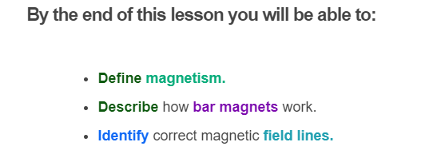
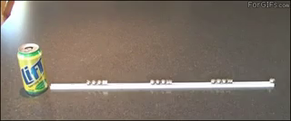

Slide 3
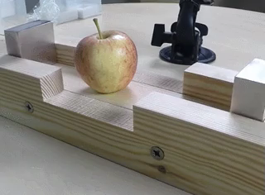
Magnets are pretty important in our daily life.
They are everywhere! In our headphones, our computers, medical equipment and even in our credit cards!
Lets look at how they work!

Slide 4
Magnets can attract objects without actually touching them - thus they create a non-contact force.
Magnets create a magnetic force which acts on other objects. This is because they have a magnetic field which can attract (pull) or repel (push).

Slide 5
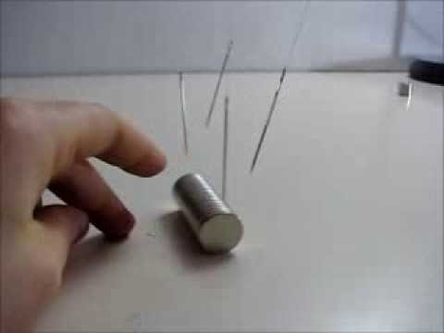

Slide 6
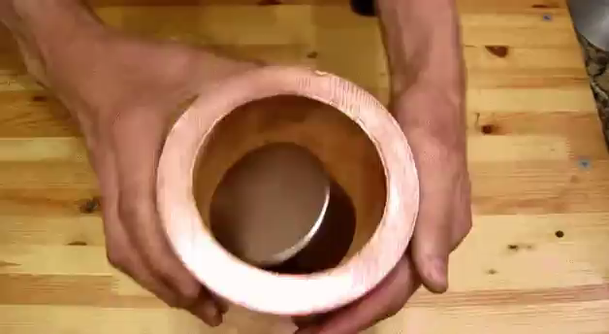
Magnets can repel or attract other magnets.
They can also attract objects made of iron, nickel or cobalt.
An alloy is a metal made by combining two or more metals. Alloys made of iron, nickel or cobalt are attracted to magnets.
For example, steel is attracted to magnets and is an alloy of iron.

Slide 7
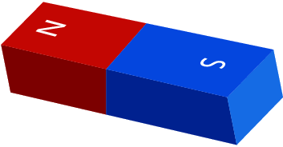
All magnets, no matter what they look like, have one side (or pole) called 'north' and one pole called 'south'.
We give the north pole the symbol N and south pole the symbol S.
Magnets always have a north and south pole, even if you cut one in half!
The magnet shown is a bar magnet. Bar magnets are permanent magnets, meaning that they always have a magnetic field.

Slide 8

If you bring the same poles (like poles) together on two magnets, they will push away from each other.
For example, when two south poles are brought together, the magnets will push away or repel.
The same thing happens when two north poles are brought together. The magnets will push away or repel.

Slide 9

If you bring a north pole and a south pole together, the magnets will pull or attract each other.
Remember, like poles repel and opposite poles attract!

Slide 10
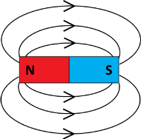
A magnetic field is the space around a magnet where a magnetic force is experienced.
Every magnet emits a magnetic field. The lines and arrows below represent the magnetic field around the bar magnet.

Slide 11
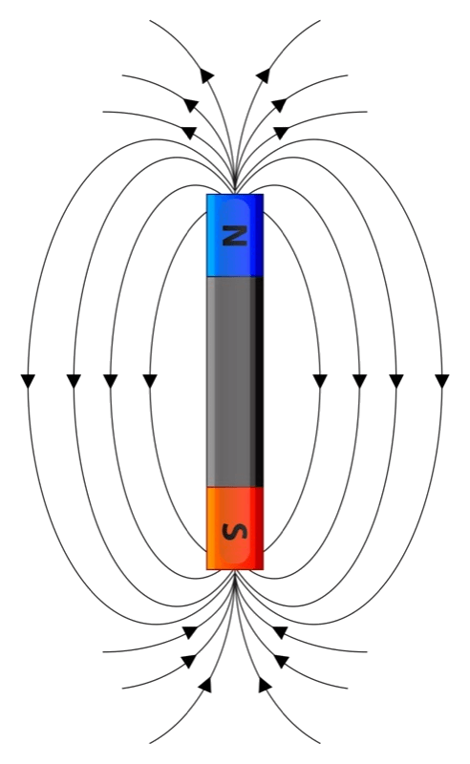
Every magnet has an invisible magnetic field around it.
We can draw a representation of the magnetic field with lines and arrows. These are field lines.
Notice that the field lines go out of the north pole and into the south pole and must never cross over. We always draw field lines like this.
Where the field lines are closest, the magnetic force is stronger.

Slide 12


Slide 13
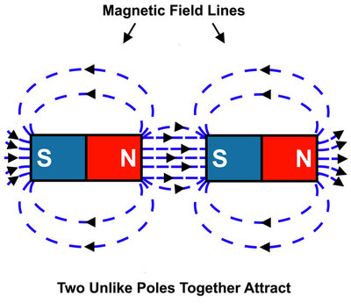
Lets look at what happens to the field lines when a second magnet is introduced.
When two magnets are attracting each other, there will still be field lines that travel from the north pole to the south pole of each magnet.
But now there are also field lines that go from the north pole of one magnet to the south pole of the other magnet.
In the diagram we can see that the field lines are short. This means there is a strong magnetic force between the two unlike poles. Therefore, the magnets will be attracted to each other.

Slide 14
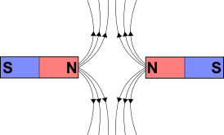
There are no field lines between like poles, therefore the two poles don't attract each other.
It's a bit trickier to explain why like poles repel.
We don't need to worry about this too much though - just make sure you know what the field diagrams look like.

